Slide 1
Development of Green and Smart System for Wastewater Treatment and Recycling for Irrigation and Cultivation Uses RUSTIC
Prof. Ranya Amer
Professor of Environmental Biotechnology
City of Scientific Research and Technology Applications
SRTA-City

Slide 2
RUSTIC Objectives
The idea of RUSTIC is to use the domestic wastewater for irrigation which will be controlled using smart system
The system is Natural Based Solution (NBs) with low cost
RUSTIC is able to solve many current issues at the same time
Provide water for irrigation
Treat domestic wastewater instead untreated discharge
Decrease the illness spread
Protect the houses from corrosion
Clean the soil from the high salt concentration
Farmers will be able to cultivate their own vegetable and fruits
Less consumption of water for irrigation

Slide 3
Who will be using RUSTIC?
People who lives in area without wastewater treatment system and they want to cultivate their lands.
The competitive advantage of RUSTIC
RUSTIC is different than any other wastewater treatment recycling system as it is affordable price cause it is natural based solutions.
It can be used for one household or central for many at the same time.
The produced water can be used for soil wash then for drip irrigation.

Slide 4
The Impact and Application
Economical Impact
RUSTIC will impact the economy by increasing the healthy people who will be able to work.
The idea can be used as startup for business model
Large scale system will increase the opportunity for new job vacancies
Increase in income or at least decrease in their expenses
Social Impact:
People will be aware with the importance of water, they will be more healthy
Environmental Impact
RUSTIC is a great adaptive solution for climate change specially in water scarcity
No use for energy cause it all depends on the gravity for water movement
Wind turbines can be used for mixing if needed
Sustainable Development Goals
End poverty
Good Health and welbeing
Clean Water and Sanitation
Decent work and Economic Growth
Industry Innovation and Infrastructure
Sustainable Cities and Communities
Responsible Production and Consumption
Climate Action

Slide 5
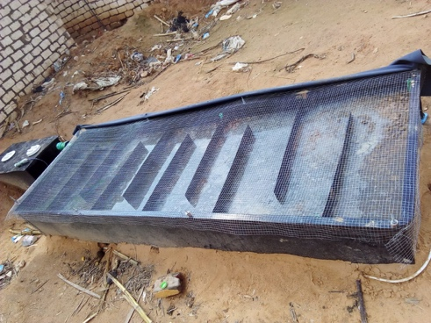
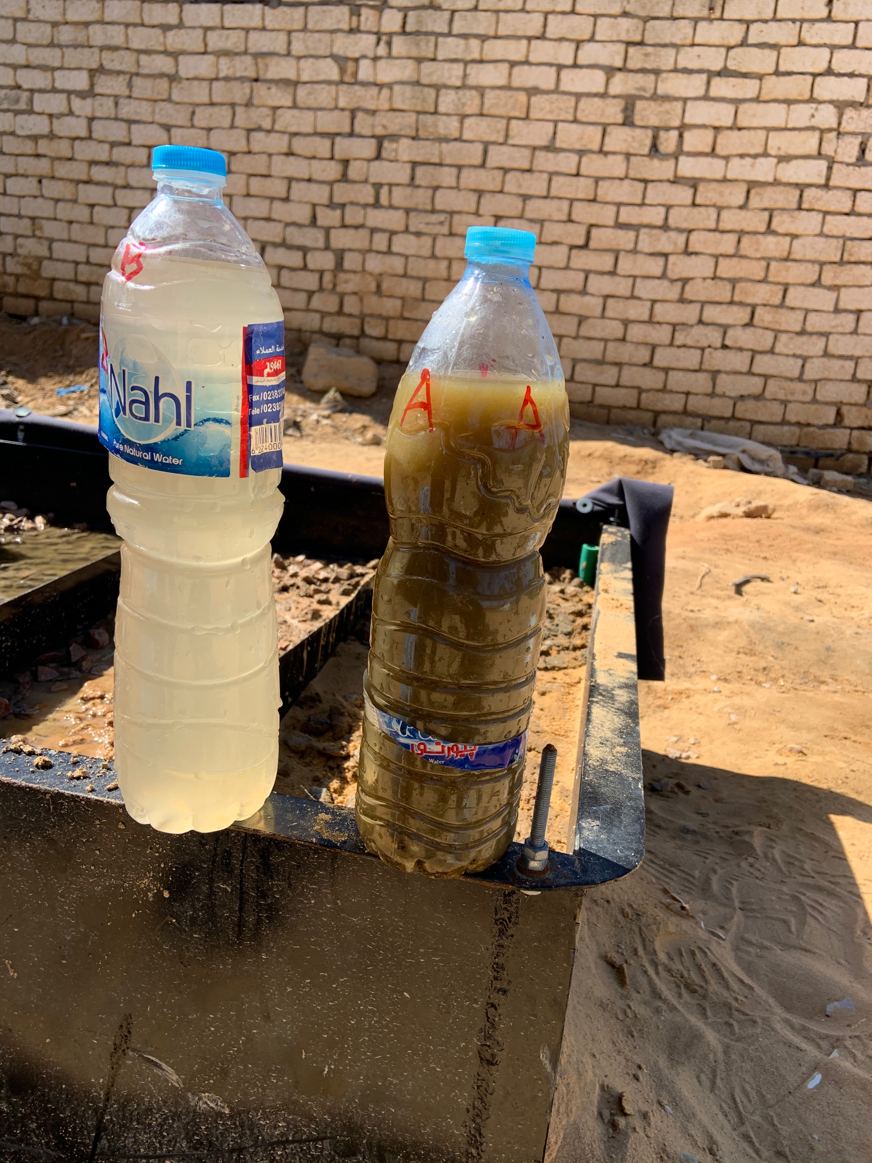
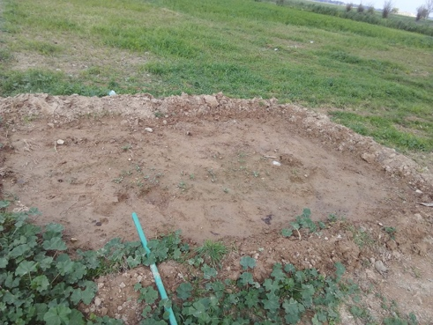
RUSTEC pilot system in is already installed for one house hold at El Bangar village in Alexandria
Our objective is to improve the system to get better water quality to be used for irrigation and then can be scaled up for more houses.

