Slide 1
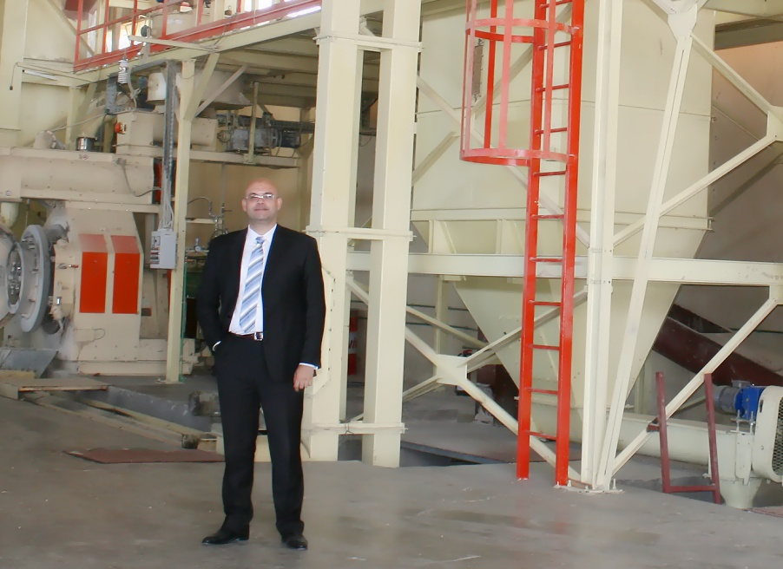
Founder Profile
Hossam Youssef, Founder and CEO, Owner of a 70%-stake:
Mr. Youssef is an Egyptian citizen, holding a BA in Economics from Cairo University 1993.
Mr. Youssef participated in the establishment of EFG-Hermes, where he spent around 11 years. His last position was Brokerage’s Vice President.
In 2006 he initiated and held the position of the Managing Director of Pharos Securities.
Mr. Youssef switched his career to industry in 2007 based on his belief that industry is one of the best long term career planning areas.
Based on the studies, Mr. Youssef decided to choose the renewable energy industry, which is currently the trend for environmentally friendly new resources of energy worldwide.

Slide 2
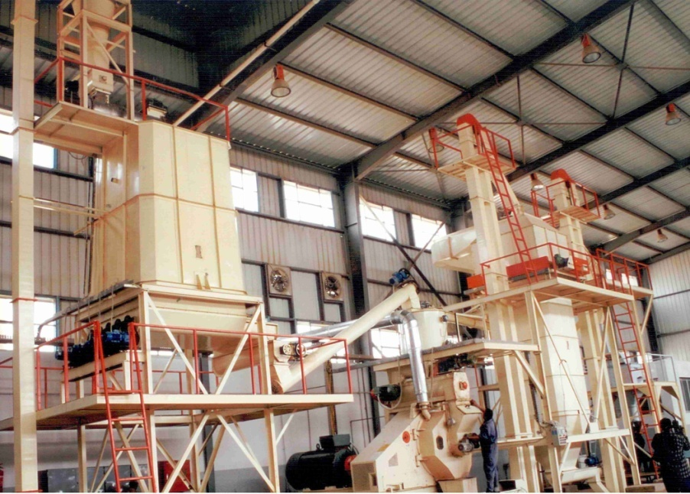
UC Land Reclamation Fact Sheet
Purpose
In 2007 Establishing and operating a plant for recycling agricultural and non agricultural wastes.
The Company uses wood scrap, saw dust and different agricultural wastes to produce an alternative clean and environmentally friendly source of energy for both residential and industrial use.
Capital
The Company’s Total investment is 20 million EGP.
Production Facilities :
The factory located in the industrial zone of Bayad El-Arab, Bani-Suef. Land area is 27900 m².
All the production line is of Italian origin. Its annual capacity is 20,000 tons of Wood Pellets.
This factory is the first one to be established in Africa and the MEA Region. Latterly, It was the first certified En-Plus factory as well.
In 2016 we added a separate line for producing Crushed Olive seeds which is the first one in Egypt. All its production are exported while the fines are sold as animal feed. We are increasing the capacity to reach 10 K tons per year.

Slide 3
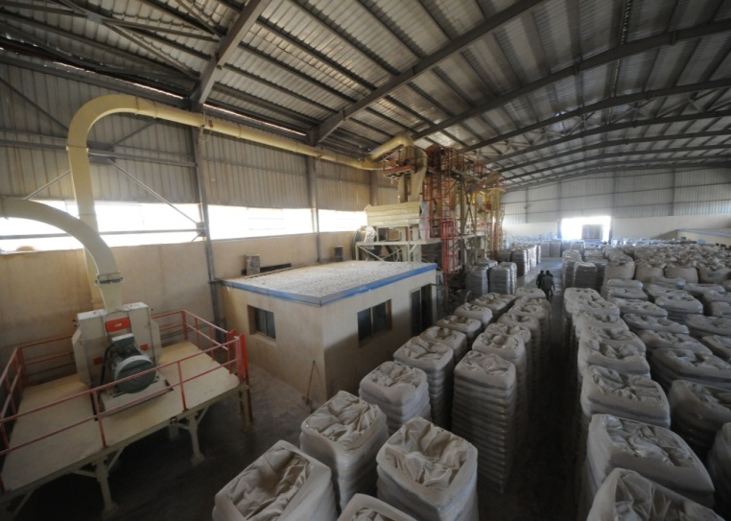
UC Wood Recycling Fact Sheet
Purpose
In 2010 Establishing and operating a plant for recycling agricultural and non agricultural wastes.
The Company uses wood scrap, saw dust and different agricultural wastes to produce an alternative clean and environmentally friendly source of energy for both residential and industrial use.
Capital
The Company’s investment is 25 Million EGP.
United Company for Land Reclamation & Agro Industries owns 99 % of this company’s shares.
Production Facilities :
The factory located in the New Damietta industrial zone, Damietta. Land area is 7800 m².
All the production line is of Italian origin. Its annual capacity is 40,000 tons of Wood Pellets.
This factory is the Second to be established in Africa and the MEA Region. Latterly, It was certified En-Plus factory as well.
In 2020 we added a separate line for producing Wood Briquettes which is the first one in Egypt. All its production are exported. The annual capacity is 9000 tons.

Slide 4
Why Wood Pellet ?
Wood pellet technology made its debut during the oil energy crisis in the 1970s when alternatives to fossil fuels were sought. Wood pellet making technology essentially came from the adaptation of animal feed pellet lines to woody materials. Europe, in particularly Sweden, was pioneers in the development of wood pellets. Sweden, due to its prominent timber industry and its willingness to be energy independent, designed the first operational plant in 1980s. With the price of oil recovery, the wood pellet alternative was considered less interesting until the 2000s. However, with rising environmental concerns and worries about fossil fuel consumption, wood pellets started being considered a reliable and concrete alternative across World Wide specially in Europe. Since then, wood pellet production and consumption has shown continuous growth which accelerated in the 2000s, making the EU n°1 in using wood pellets.
Pellets can be delivered in bulk and deposited directly in dedicated individual containers similar to the way gas stations are restocked with gasoline. In the meantime, the quality of wood pellet material was homogenized and guaranteed through the development of the certification scheme ENplus helping to make pellets a standardized commodity.
In general, biomass materials tend to have high moisture content. When considering using those for heating, moisture content is central as it decreases combustion performance. Moreover, the weight and volume of biomass increase transportation costs and make storage harder. In the mean while, wood pellets are limiting the cost of transport and storage which make them competitive compared to fossil fuel. Typically, wood pellets are stored in a silo (similar to those housing grain) or other type of tank. Wood pellets can be conveniently stored for years.

Slide 5
Local Market Overview
Egypt is currently facing a real challenge in terms of energy resources.
Despite of its negative environmental effects, Coal emissions result in CO which is considered a main cause of Global Warming. Whereas agriculture waste result in CO². Coal is currently being targeted as a substitute to natural gas and electricity for power supply in industrial use in Egypt.
Egypt enjoys natural resources for renewable energy such as the solar power and the agriculture wastes.
Egypt has around 15 million tons annually of different agriculture wastes. 1 million tons of which are collected , whereas the remainder are being burned causing pollution and severe health issues.
The recycling of the agriculture wastes started in the 1980s, with the manufacturing of the compost and fertilizers, which roughly do not utilize more than 5% of the produced waste.
With the start of the energy shortage in Egypt, Cement factories started to rely on the agriculture wastes as a cheap resource of energy compared to Coal prices that has to be paid with hard currencies (U$).
In general, agriculture wastes tend to have high moisture content. When considering using those for power, moisture content decreases combustion performance. Moreover, the weight and volume of agriculture wastes increase transportation costs and make storage harder, so that more than 50 % from the final price cost is paid for the transportation which means waste of money.

