Slide 1
المبادرة الوطنية للمشروعات الخضراء الذكية

Slide 2
محطة متنقلة لتحلية مياه البحر تعمل بالطاقة الشمسية بالشلاتين

Slide 3
Mass production of a small mobile photovoltaic driven water desalination plant.
Project funded by: Academy of Scientific Research & Technology
Hosam A. Shawky
Professor of Water Chemistry
Director, Egyptian Desalination Research Center of Excellence (EDRC)
Vice President for Projects & Research Stations
Desert Research Center
shawkydrc@hotmail.com
Hashawky@edrc.gov.eg
+2 01002930710

Slide 4
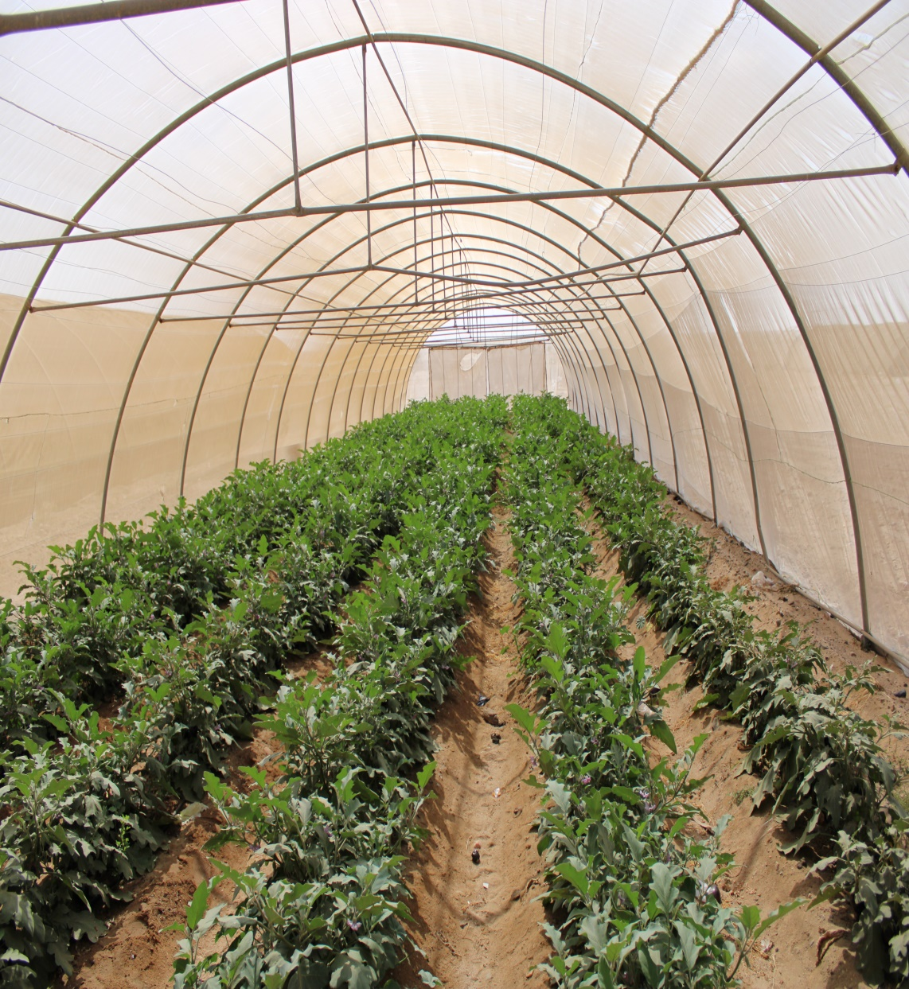
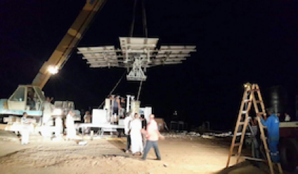
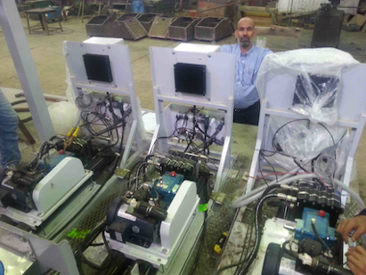
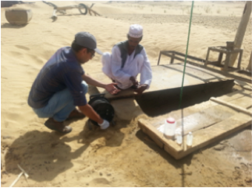
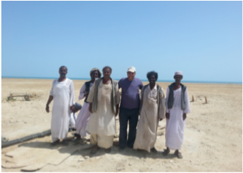
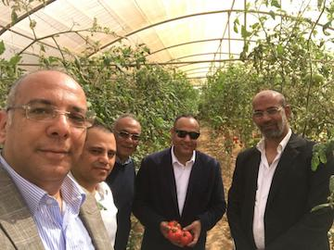
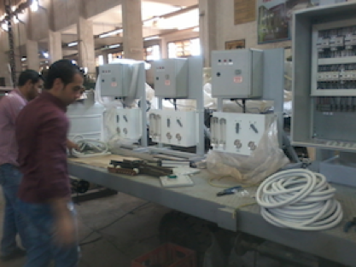
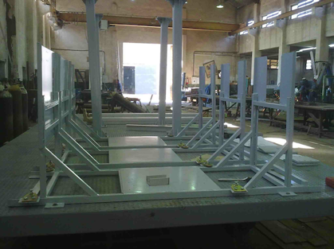
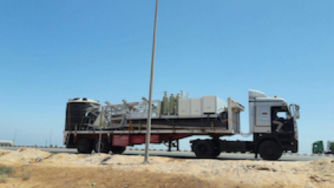
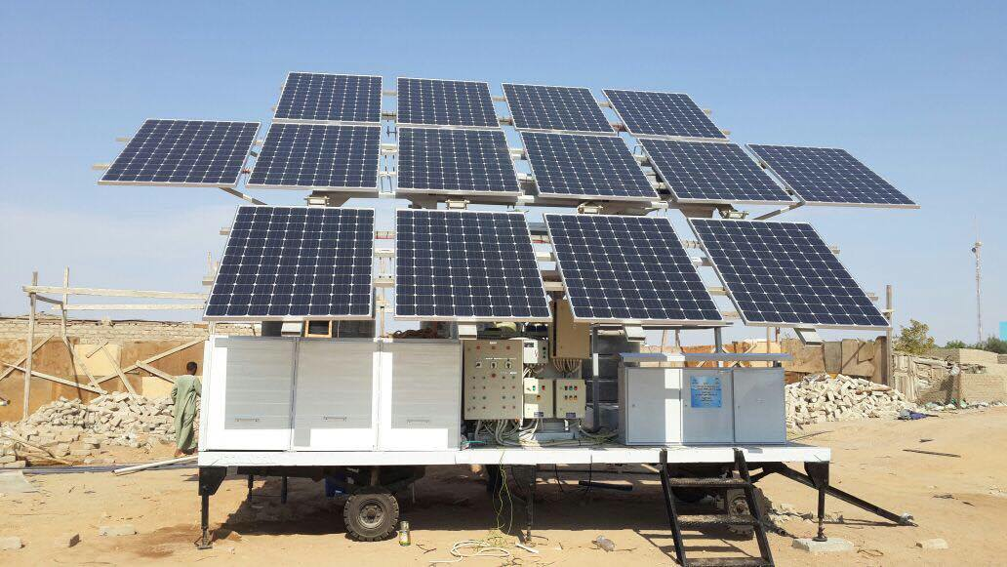
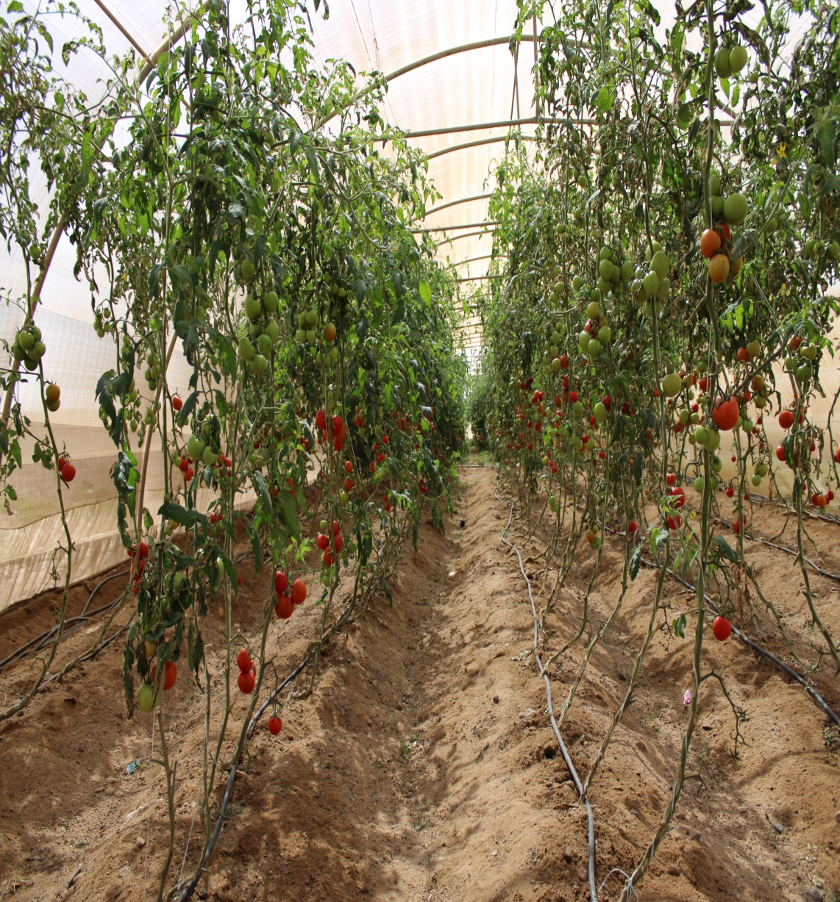
Design of a small mobile PV driven RO water desalination plant to be deployed at the north west coast of Egypt

