Slide 1
Electronic Ticket System
Alexandria Passenger Transportation Authority APTA
National Initiative For Smart Green Projects

Slide 2
Project Presents
Name :- Mohamed Ahmed Abd El-Rehem Ebid. • Entity name :-Alexandria passenger transportation authority. • Occupation :- an official in the electronic ticket system. • Scientific experiences :- Bachelor of Commerce, Accounting Department, English Division. • Experiences :- Database Administrator , PHP Designer.
About The Project • Name of the project :- Electronic Ticket System. • Idea of the project :- Digital transformation from traditional tickets to electronic ticket system and then to integrated ticketing. • Beneficiary category :- Alexandria citizens. • Competitive advantage :- the only governorate in Egypt that implement the electronic ticket system.

Slide 3
Alexandria passenger transportation authority(APTA) has contracted with General Intelligence Service (GIS) to establish and activate the infrastructure of electronic ticket system through (Delta electronic system) company. • The implementation of the electronic ticket system in APTA's vehicles has caused an electronic boom as it makes available various alternatives to the traditional tickets; moreover ,it controls the cash flow in APTA according to the directives of the state and the general policy of APTA. • The project has been inaugurated on the 30th of October, 2021, in Sidi Gaber area and implemented in bus sector.

Slide 4
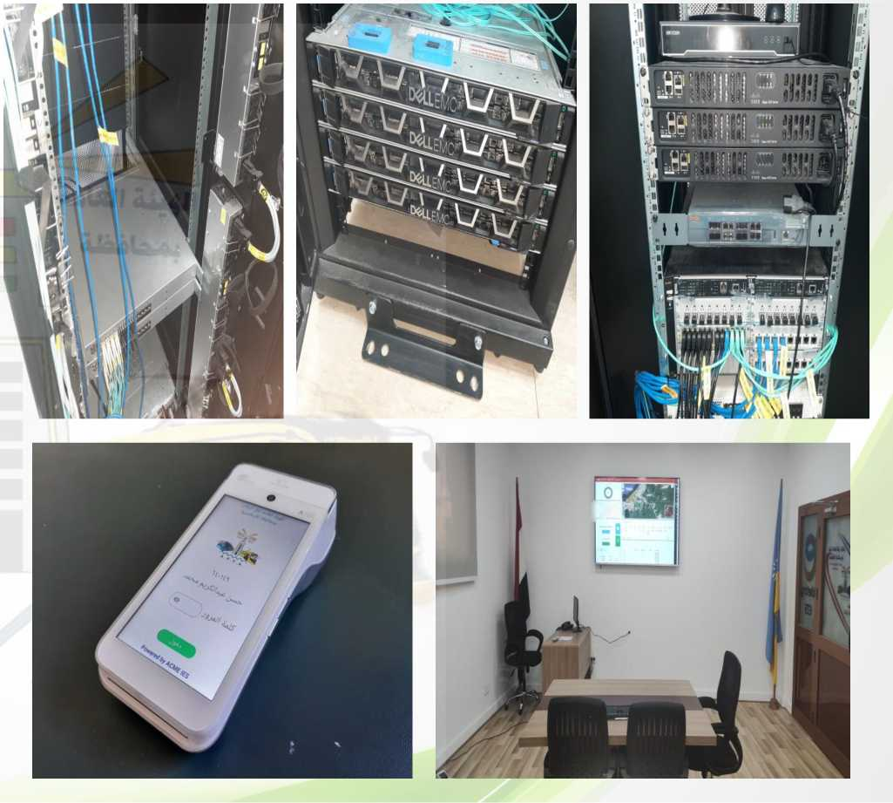
The infrastructure of the electronic system consists of:
A control room containing servers that serve the system and its connection devices.
A control room for monitoring the fleet and for instantaneous follow-up.
Handheld devices with the collectors.
Revenue collection cente
ه٥

Slide 5
Benefits of the system includes but not restricted to the following:- • Monitoring the fleet by the way of instantaneous tracking of the handheld devices through the GPS system which is applied in all devices.
Making available accurate data and reports which help in making accurate and quick decisions.
Determining the places and periods of traffic jams accurately so as to improve the service provided.
Verification of the revenues by the use of a smart electronic system.
Reduce harmful emissions by encouraging citizens to use public transportation instead of private vehicles, as they have confidence in the service provided.
Use of co-friendly lithium battery.

Slide 6
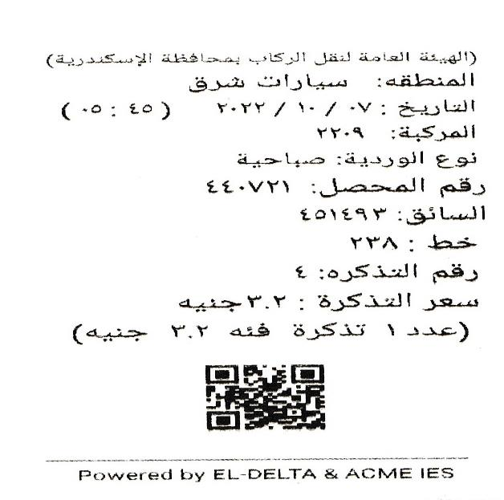
Current situation :-
The first phase has already been implemented .ln this phase the passenger pays in cash and the collector extracts a paper ticket from the handheld device .This ticket includes all the data of the trip as follows :-
Future plans:- After the implementation of the first phase of the system a study is currently being conducted on how to activate the prepaid system for the use of prepaid cards in coordination with the secure and the smart version aggregator of the military intelligence authority of the ministry of defense This is to be followed by a study on activating the prereservation of trips via mobile applications.

