Slide 1
Conversion of carbon dioxide gas to sustainable fuel via smart filters
تحويل غاز ثاني أكسيد الكربون إلي وقود مستدام عن طريق فلاتر ذكية
By
Dr. Mahmoud Elrouby
Associate Professor
King Salman International University, South Saini

Slide 2


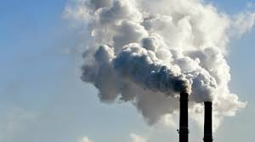
Climate Change and CO₂
The Problem

Slide 3


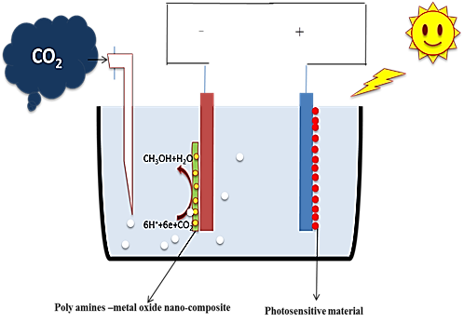
The challenge
Establishing and constructing of inexpensive, effective, and selective system to produce fuel from the unwanted and harmful gas (CO₂).
The Idea
Smart filter is a catalytic photosensitive converter can do the following:
1- capturing the CO₂ effectively via naturally extracted polymer.
2- convert the CO₂ into a fuel via sunlight.
Then it should contains suitable materials to do this mission
The development of photo-electrochemical CO₂ conversion is one of our main research aims via smart nanocomposite materials
Proposed system

Slide 4
Tasks and time schedule

Slide 5
Expected outputs
Producing economical, highly efficient, selective, and novel smart materials based on naturally extracted polymers-metal/metal chalcogenides nanocomposites as cathodes which will provide next-generation towards the green conversion of CO₂ into chemical fuel as a contributor for energy problem-solving and overcome the pollution and energy deficiency problems as an alternative sustainable resource, that in accordance with 2030 Egypt vision.
Design of working prototype introduced for marketing in industrial society.
Training of graduates.
Other outputs will be in the form of Promoting the national industry.
Budget
البند | التكلفة جنيه مصري
عمل نموذج أولي من الفلتر الذكي المحفز | 600000
تجهيزات وكيمياويات وتحاليل و أجهزة | 700000
نظام تحكم آلى وربطها بالخلايا الشمسية | 700000
إجمالي التكلفة | 2مليون جنيه مصري

