Slide 1
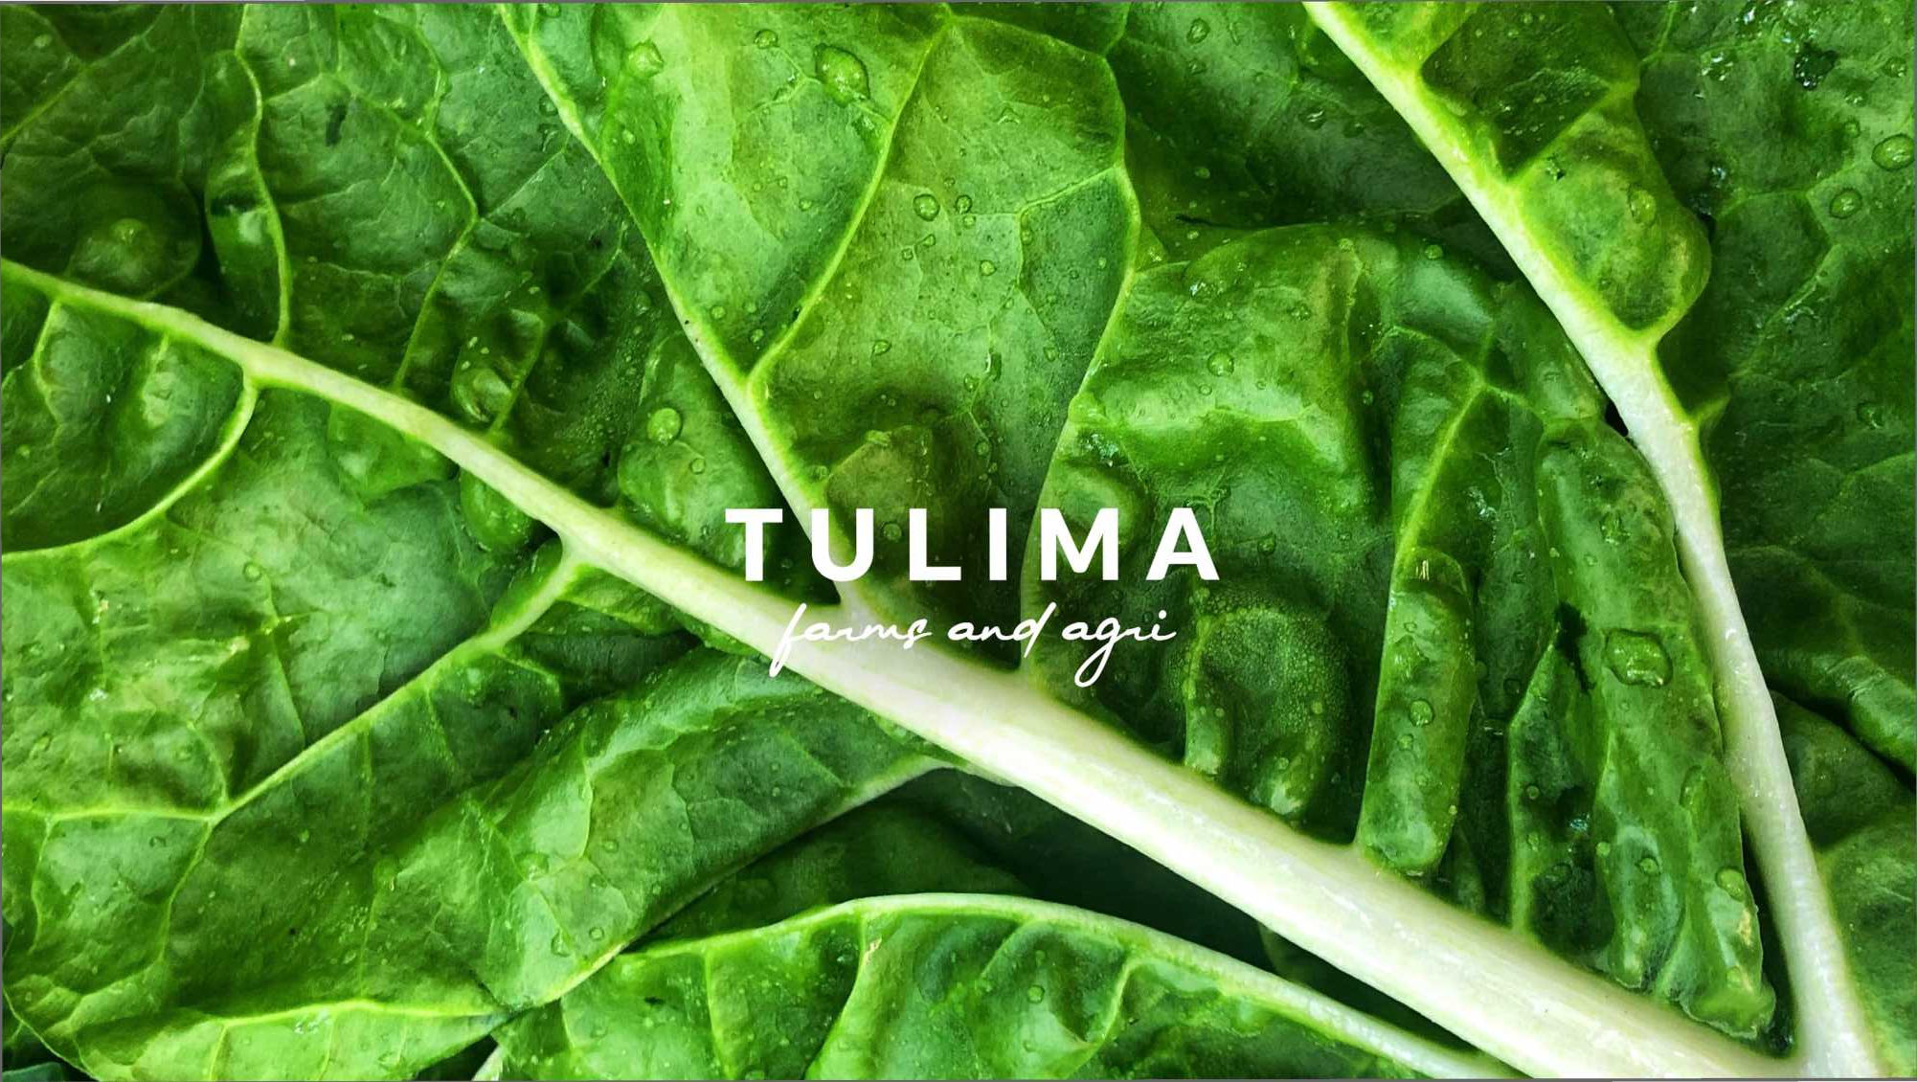

Slide 2
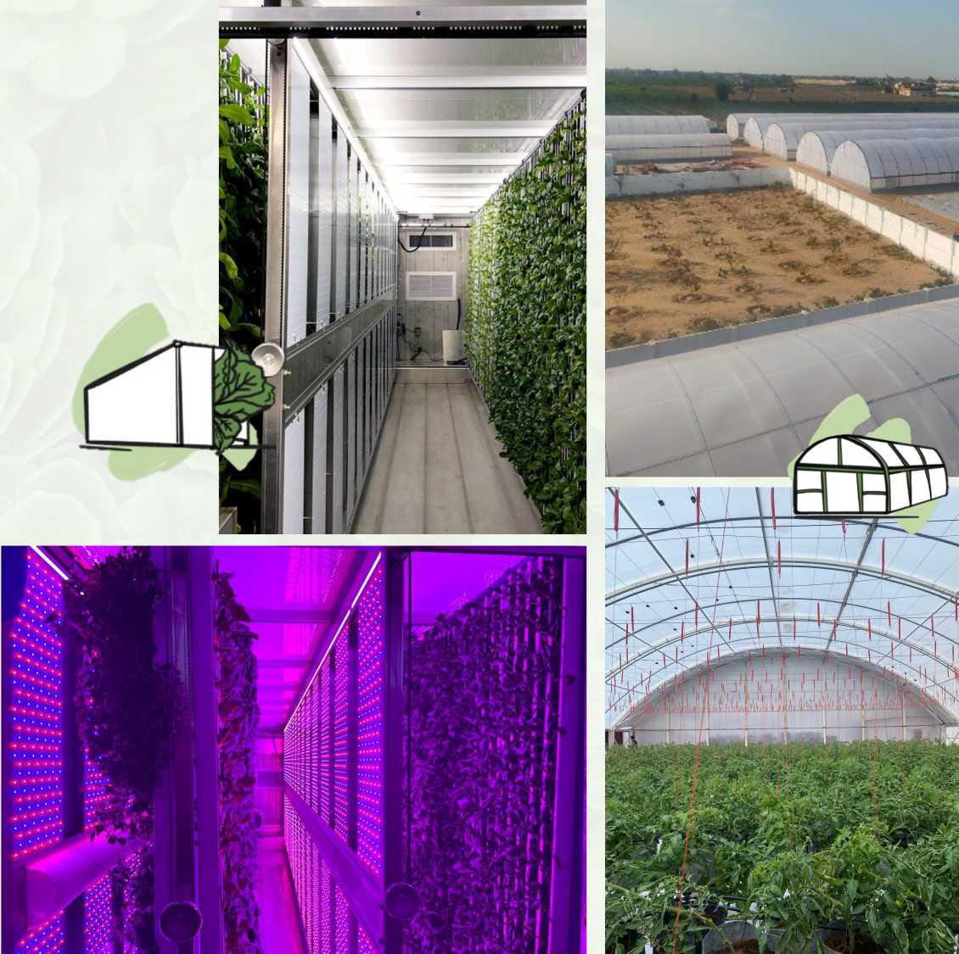
Tulima Profile
• A 20 Feddan farm in El Beheira, transformée into a high yielding, resourceful, climatepositive and socially responsible pilot farm.
• We farm hydroponically using NFT tables, grow bags, vertical towers, by incorporating the most advancee farming techniques being usee in the field today.
• We operate state-of-the-art data-driven, climate-controlled, biosafe, polycarbonate greenhouses, growing delicious, pesticide free produce with no connection to seasonality.
• Running Egypt’s first container farms, growing the equivalent of 2.5 acres in a 28m2 space, 365 days a year using less water, electricity and lane.
• Through precision farming we are able to produce high yields in a small area while using less water, electricity and land. All while having a low environmental impact.
• Growing wieeiy eeiicious proeuce, benefiting the people, communities ane our pianet.

Slide 3
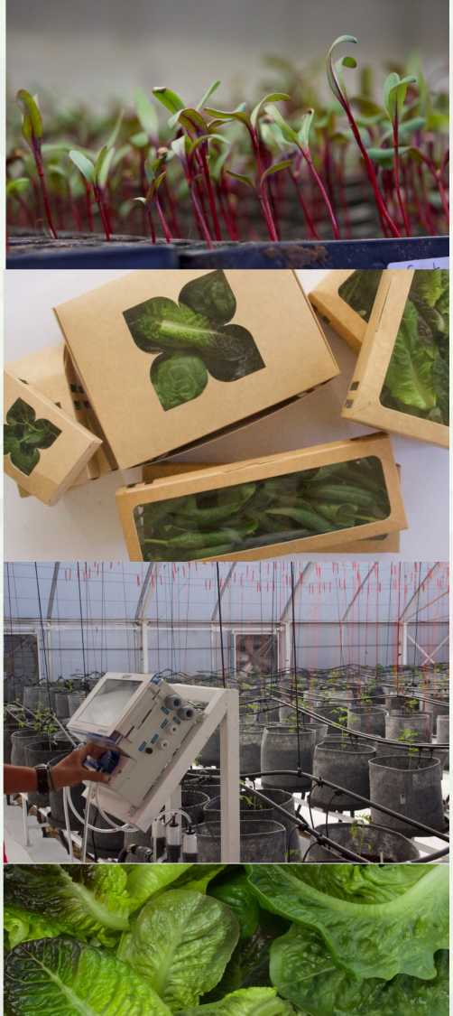
Competitive Advantages
• Agriculture that is high-tech, precise, and environmentally friendly has been shown to reduce costs while increasing output.
• This allows us to better price our products and reach a broader customer segment
• Tulima provides healthy, pesticide¬free produce that is available 365 days a year and is grown to the highest food safety standards.
• Controlled-environment agriculture allows us to grow off-season produce, refraining from importing off-season vegetables.
• Continuous, all year round produce of hotels and restaurants
Identifying Target Market
The Egyptian local market and export market.
Individuals who want to eat nutritious, tasty, pesticide-free, and environmentally friendly produce
Consumers who are aware of the current global resource crisis, such as water and arable land scarcity, food security, and they choose sustainable produce.
Contract- Farming for hotels and restaurants that typically rely on imported produce
Tulima believes that access to clean, pesticide free, environmentally conscious produce should be for everyone

Slide 4
Tulima Climate-Positivity
Using 90% less water than traditional farming.
Increasing yield by 10x from the same plot of land.
Generating 60% of the renewable energy on our facility
ZERO pesticide on our farms.
We recirculate our nutrient-rich water for a month, then use it in open fields rather than disposing of it as waste water.
Soilless water cultivation in high-tech greenhouses increases production by nearly 10x per square meter, compared to open cultivation..
Furthermore, consumption is monitored and controlled by computers to ensure the lowest possible usage.
We adopt and implement stringent biosecurity protocols to avoid ever using harmful chemicals to humans and Earth.
Precision Farming eliminates any nutrients waste
Using Coco Peat as a soil substitute
No seasonal Limitations
Focusing on extending the shelf-life
We closely control and monitor each stage of the growing cycle, providing our crops with precise amounts of nutrients in recycled water. Eliminating wastage and ground water contamination
Using a natural substrate allows us to eliminate diseases caused by soil degradation, reuse it multiple times, and ensure biodegradation after use.
For 365 days a year, we grow in climate-controlled greenhouses and shipping containers. Providing consistent supply regardless of season.
Using the most recent methods available to naturally extend the shelf-life of our produce, we are able to reduce food waste.
Minimizing our post-consumer packaging waste
We reuse, recycle and upcycle materials
Zero Agricultural Waste
٠،
Local production all year long
nl In
We use recycled cardboard, kraft paper and biodegradable for our packaging
We upcycle materials such as wood, plastic, and metal to create new functional products for our farms.
Agriculture waste from pruning and trimming is recycled into organic materials used as soil fertilizers for openfield farming. .
Providing a local alternative to importing produce, which results in CO2 emissions and food miles travelled.

Slide 5
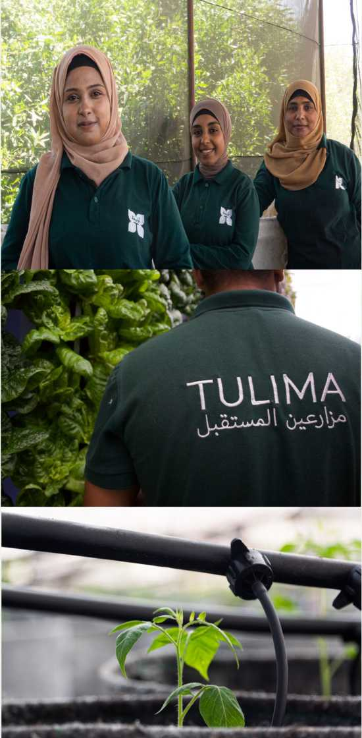
Social Responsibility
• Our produce is the best not only because of how we grow it, but also because of who grows it. Our greenhouses were built by simple farmers who we taught news skills and are now our pride and joy.
• We’re committed to empowering underprivileged members of the community we work within, by providing jobs, training, and opportunities.
• Creating an educational center on the farm to teach intensive courses in (literacy - English -computer) not only for our team, but also for the surrounding community.
• We are dedicated to empowering women in a traditionally male-dominated field in rural areas.
• We are gender, color and religion blind.
• 85% of our team are under the age of 30
• We offer part-time jobs for Agriculture students in universities to train and gain experience in the field.
• Spreading awareness about hot-topics in the world today, such as climate-change, gender equality and food security through our digital presence
Economic Impact
• Modern farming methods have been shown to be profitable without sacrificing quality, yield or having an environmental impact.
• Chemical pesticide-free products command higher selling prices in local markets and export markets, increasing revenues and improving farmers livelihoods.
• Through precision farming in our greenhouses, allows us to produce 10x the yield from the same plot of land.
• By increasing our yield, we can sell our produce at a lower price than what is currently available on the market, allowing us to reach as many families as possible.
• Tulima aims to break the stereotype that clean, pesticide free, environmentally friendly produce must be sold at a highest price and is only aimed at a certain social class

Slide 6
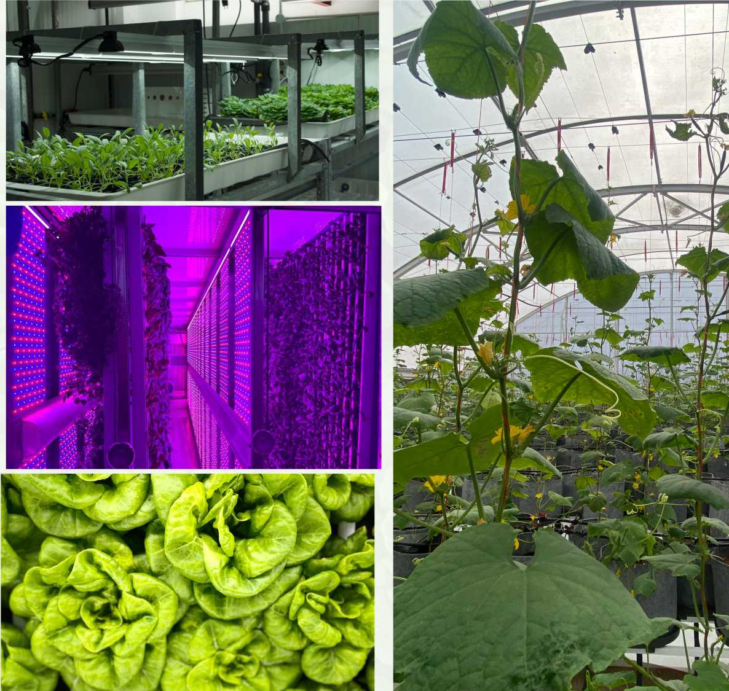
Two to Three Expansion Plan
• By 2025, Tulima plans to be 85% solar powered. Purchasing carbon credits, deliver produce by electric vehicle, reach 0 plastic on the farm, and advocate for a greener future.
• Constructing greenhouses on the 2 acres of land currently available at Tulima Tahrir, to cover more areas of Egypt
• Purchasing 10 acres of land and constructing greenhouses to produce an abundance of vegetables for export
• Purchasing 10 container farms to relocate them within urban cities to keep vegetables fresh from the farm, directly to the consumer, reducing Co2 emissions and harmful gases caused by food miles travelled.

